Slide 1

TECHNICAL ARCHITECTURE BRIEF
Test Driver Enhancement Strategy
Reliability, Resilience & Self-Healing Framework
Implementation Roadmap and Key Features
PHASE 1-3 DEPLOYMENT
•
AI-DRIVEN AUTOMATION
•
AUTONOMOUS QA PLATFORM

Slide 2

The Challenge - Why Traditional Testing Falls Short
Traditional test automation faces critical limitations that undermine software quality:
The Cost of Limitations:
40%
Constant Manual Maintenance
Tests break frequently when UI elements change, requiring continuous manual updates that consume up to 40% of QA resources.
of QA resources consumed by test maintenance
2-3
Flaky Test Epidemic
Static waits and brittle selectors create unreliable tests that produce false failures, eroding team confidence in automation.
days average release delay per sprint due to flaky tests
10-100×
Debugging Overhead
higher cost to fix production defects vs. catching during development
Teams spend hours determining whether failures indicate real bugs or broken test scripts.
Limited Scope
Organizations report that test maintenance consumes more effort than test creation, fundamentally undermining the value proposition of automation.
Traditional frameworks only validate functional correctness, missing security vulnerabilities, performance regressions, and accessibility violations.

Slide 3

The Vision - Autonomous Quality Assurance Platform
Transform Test Driver into an intelligent, self-healing system that delivers comprehensive quality assurance
The enhanced framework represents a fundamental shift from reactive test execution to proactive quality engineering. By integrating AI-driven self-healing, multi-dimensional testing, and predictive analytics, the system will autonomously detect, diagnose, and resolve testing issues while providing holistic visibility into application quality.
Four Foundational Pillars
01
02
Automatic Adaptation
Multi-Dimensional Testing
System automatically adapts to application changes, healing broken tests without human intervention.
Expand beyond functional testing to validate security, performance, accessibility, and compliance in a unified workflow.
03
04
Predictive Analytics
Seamless CI/CD Integration
Advanced telemetry and machine learning enable predictive failure detection, catching issues before they reach production.
Continuous quality feedback enables teams to ship faster with confidence, eliminating quality-related delays.
70%
50%
Accelerated
Reduction in test maintenance effort
Increase in defect detection
Release velocity with confidence

Slide 4

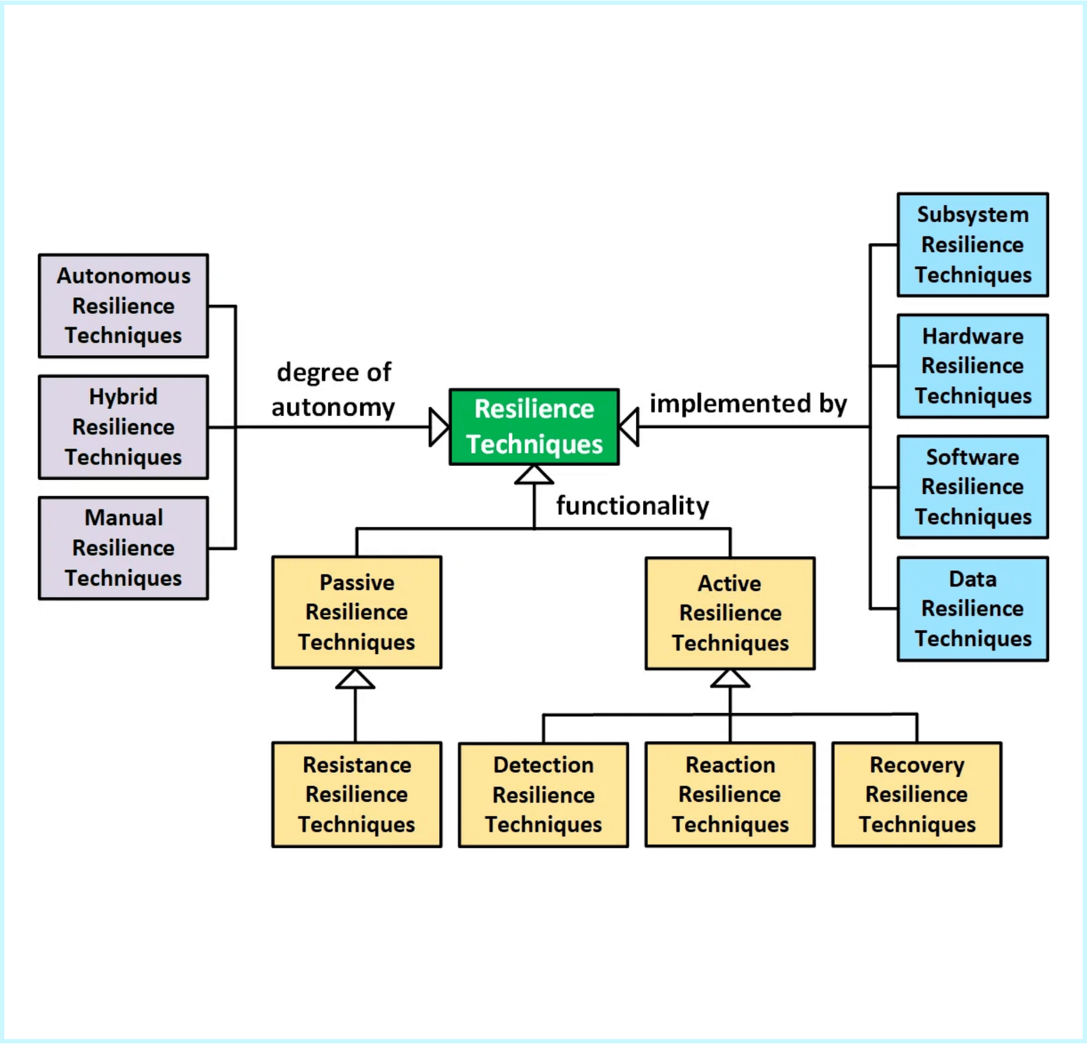
Framework Architecture - Four Integrated Layers
The framework is organized into four distinct but interconnected layers, each addressing a critical aspect of test automation quality.
1. Reliability Layer
State Synchronization Store tracks application state for graceful recovery. Deterministic Replay Engine enables pixel-perfect test reproduction. Adaptive Wait Service uses AI-powered visual stability detection.
2. Resilience & Recovery Layer
Heuristic Recovery Engine implements intelligent fallback strategies. Hot-Swappable Module Manager monitors adapter health and enables dynamic reloading. Chaos Engineering Controller proactively tests system resilience.
3. Self-Healing Intelligence Layer
AI Locator Healing Service uses vision embeddings to identify new element locators. Anomaly Learning Engine applies reinforcement learning to failure patterns. Environment Drift Detector compares UI snapshots to trigger healing.
Modular, layered architecture enables progressive adoption
4. Continuous Monitoring Layer
Telemetry & Metrics Service provides real-time visibility through dashboards. Reliability Scoring Engine enables data-driven optimization of testing efforts.
Design Principle: Each layer can be deployed independently, allowing teams to adopt capabilities progressively based on their maturity and needs.

Slide 5

Self-Healing Intelligence - How AI Fixes Broken Tests
When a test fails due to a changed UI element, the Self-Healing Intelligence Layer initiates a sophisticated recovery process that combines computer vision, semantic search, and machine learning to automatically identify and update element locators.
Autonomous Healing Process
STEP 1
STEP 2
STEP 3
STEP 4
Analyze Historical Context
Vision-Based Search
Evaluate Candidates
Auto-Update & Persist
System analyzes historical screenshots and DOM metadata to understand the element's previous context and appearance.
Computer vision embeddings perform semantic search across current UI to identify element's new location.
Scoring algorithm considers visual similarity, textual content, spatial relationships, and functional context.
High-confidence matches (>85%) trigger automatic locator updates and pull request creation for review.
This process occurs transparently during test execution. If healing succeeds, the test continues without interruption. The updated locator is persisted to a learning database, improving future healing accuracy. Over time, the system builds comprehensive understanding of UI patterns, enabling it to predict and prevent failures before they occur.
60-80%
90%
>85%
Reduction in test maintenance effort
Success rate in automatic locator healing
Confidence threshold for auto-commit

Slide 6

Expanded Testing Scope - Beyond Functional Validation
Holistic quality assurance requires validating security, performance, accessibility, and data integrity in addition to functional correctness
Security & Privacy
Identify and mitigate security vulnerabilities and privacy risks through SAST, DAST, SCA tools, and API fuzzing to uncover weaknesses in code, dependencies, and runtime behavior.
Performance & Load
Ensure application responsiveness, scalability, and stability under load by embedding Lighthouse metrics collection and k6 load generation directly into test execution flow.
Accessibility & Compliance
Verify compliance with WCAG standards and regulations (GDPR, HIPAA) using axe-core and Pa11y to automatically scan every page, ensuring applications are usable by people with disabilities.
API + UI Fusion
Validate consistency and integrity of data between API and UI by intercepting and validating API calls during UI tests, catching integration issues that pure UI or API testing would miss.
Behavioral AI Persona
Discover UX defects by using large language models to simulate realistic user behaviors and personas, uncovering subtle issues that scripted tests overlook.
Data Mutation Testing
Verify application robustness by injecting controlled errors into forms and APIs to validate error handling and recovery logic.
Multi-Modal Verification
Test non-visual application outputs including audio validation, video playback analysis, and file download verification.
360°
50%
Comprehensive quality visibility across all dimensions
Reduction in production defects compared to functional testing alone

Slide 7

MONTHS 0-6
Phase 1 - Foundational Reliability
Goal: Establish baseline stability and integrate critical testing dimensions to achieve immediate value
Key Features
Expected Outcomes
Feature
Priority
Complexity
40-50%
State Synchronization Store
High
Medium
Reduction in flaky test failures
Adaptive Wait Service
High
Medium
30-40%
Heuristic Recovery Engine
High
Medium
Reduction in test maintenance effort
AI Locator Healing (Basic)
High
High
Telemetry & Metrics Service
High
Medium
100+
Accessibility Scanning (axe-core)
High
Low
Accessibility & security issues detected
Security Scanning (SAST/SCA)
High
Medium
3-4 mo
Time to positive ROI
Phase 1 focuses on high-impact, medium-complexity features that provide immediate stability improvements and lay the groundwork for advanced capabilities. This phase prioritizes reliability over sophistication, ensuring the system works consistently before adding complex AI-driven features. Teams typically see ROI within 3-4 months as maintenance savings accumulate.

Slide 8

MONTHS 6-12
Phase 2 - Advanced Self-Healing & Holistic Testing
Goal: Build sophisticated recovery mechanisms and expand quality visibility across performance, API integrity, and environmental changes
Phase 2 introduces more complex, AI-driven capabilities that require the stable foundation established in Phase 1. This phase shifts from reactive healing to proactive detection and prevention.
Advanced Diagnostic Tools
Proactive Self-Healing
Deterministic Replay Engine for pixel-perfect test reproduction. Hot-Swappable Module Manager for automatic adapter recovery. Dramatically reduces time-to-resolution for complex failures.
Environment Drift Detector compares UI snapshots across builds to identify changes before tests fail. Enables preemptive healing, reducing test failures by 40-50%.
Holistic Quality Integration
Controlled Chaos Engineering
Performance Testing Module with Lighthouse integration. API + UI Fusion Testing for data consistency validation. Synthetic Data Generator for realistic, privacy-compliant test data.
Begins running fault injection experiments in staging environments to validate system resilience and test robustness. Proactively identifies weaknesses before production incidents.
Expected Outcomes
60-70%
20-30%
50-60%
Reduction in test maintenance effort (up from 30-40% in Phase 1)
Performance regressions detected that would impact users
Faster root cause analysis due to improved diagnostics
Teams report comprehensive quality visibility beyond functional correctness, with API-UI data inconsistencies identified that traditional testing misses.

Slide 9

MONTHS 12+
Phase 3 - Predictive & Autonomous QA
Goal: Evolve into a fully autonomous system that predicts failures, prevents defects, and provides intelligent debugging assistance
Advanced Autonomous Capabilities
Predictive Intelligence
AI-Powered Debugging
ML models analyze historical data, code changes, and environmental factors to forecast which tests are likely to fail, enabling preemptive healing and reducing wasted execution time by 30-40%.
LLM-based co-pilot reads failure logs, analyzes screenshots, and suggests specific code fixes or test updates, reducing debugging time from hours to minutes for complex failures.
Advanced Behavioral Testing
Full Reinforcement Learning
Large language models simulate diverse user personas (novice users, power users, accessibility-dependent users) to discover subtle UX defects through exploratory testing.
Anomaly Learning Engine continuously learns from test failures and autonomously optimizes test strategies, wait times, and recovery approaches without human intervention.
Production Chaos Engineering
Multi-Modal Verification
Carefully introduce controlled fault injection into production environments with minimal blast radius, validating true system resilience under real-world conditions.
Add capabilities to test non-visual outputs like audio, video, and downloaded files, providing complete coverage of application functionality.
Transformational Impact
80-90%
70-80%
+30-40%
40-50%
Reduction in test maintenance
Faster failure resolution
More defects discovered
Faster release velocity

Slide 10

Expected Impact & Success Metrics
Comprehensive quality assurance delivered through autonomous, intelligent testing
Efficiency Gains
Quality Improvements
70-80% reduction in test maintenance effort, freeing QA resources for exploratory testing and quality strategy
50-60% increase in defect detection through expanded testing scope covering security, performance, and accessibility
30-40% reduction in test execution time through intelligent test selection and parallelization
40-50% reduction in production defects as issues are caught earlier in the development cycle
70-80% reduction in time-to-resolution for test failures through advanced diagnostics and AI-assisted debugging
80-90% improvement in test reliability through self-healing and adaptive wait mechanisms
Business Impact
Organizational Transformation
40-50% increase in release velocity as quality gates become enablers rather than bottlenecks
QA teams shift from test maintenance to strategic quality engineering
Developers receive faster, more actionable feedback on code quality
50-60% reduction in cost of quality through automation and early defect detection
Product teams gain confidence to ship more frequently with lower risk
Improved customer satisfaction through fewer production incidents and better accessibility
The roadmap provides a clear path from foundational stability to autonomous intelligence, with measurable value delivered at each phase. Organizations can expect positive ROI within 6 months and transformational impact within 18 months.

